Slide 1
TALKIE CHAT
Jilada Eccleston

Slide 2
SYSTEM REQUIREMENTS
Users able to log in and authenticate themselves to the login server
Send and receive messages between clients
Update and view profiles
Nice user interface
Secure peer-to-peer network

Slide 3
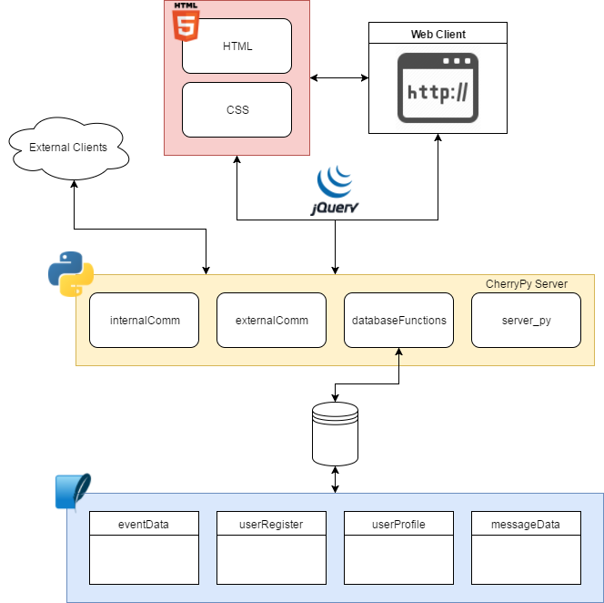
SYSTEM OVERVIEW

Slide 4
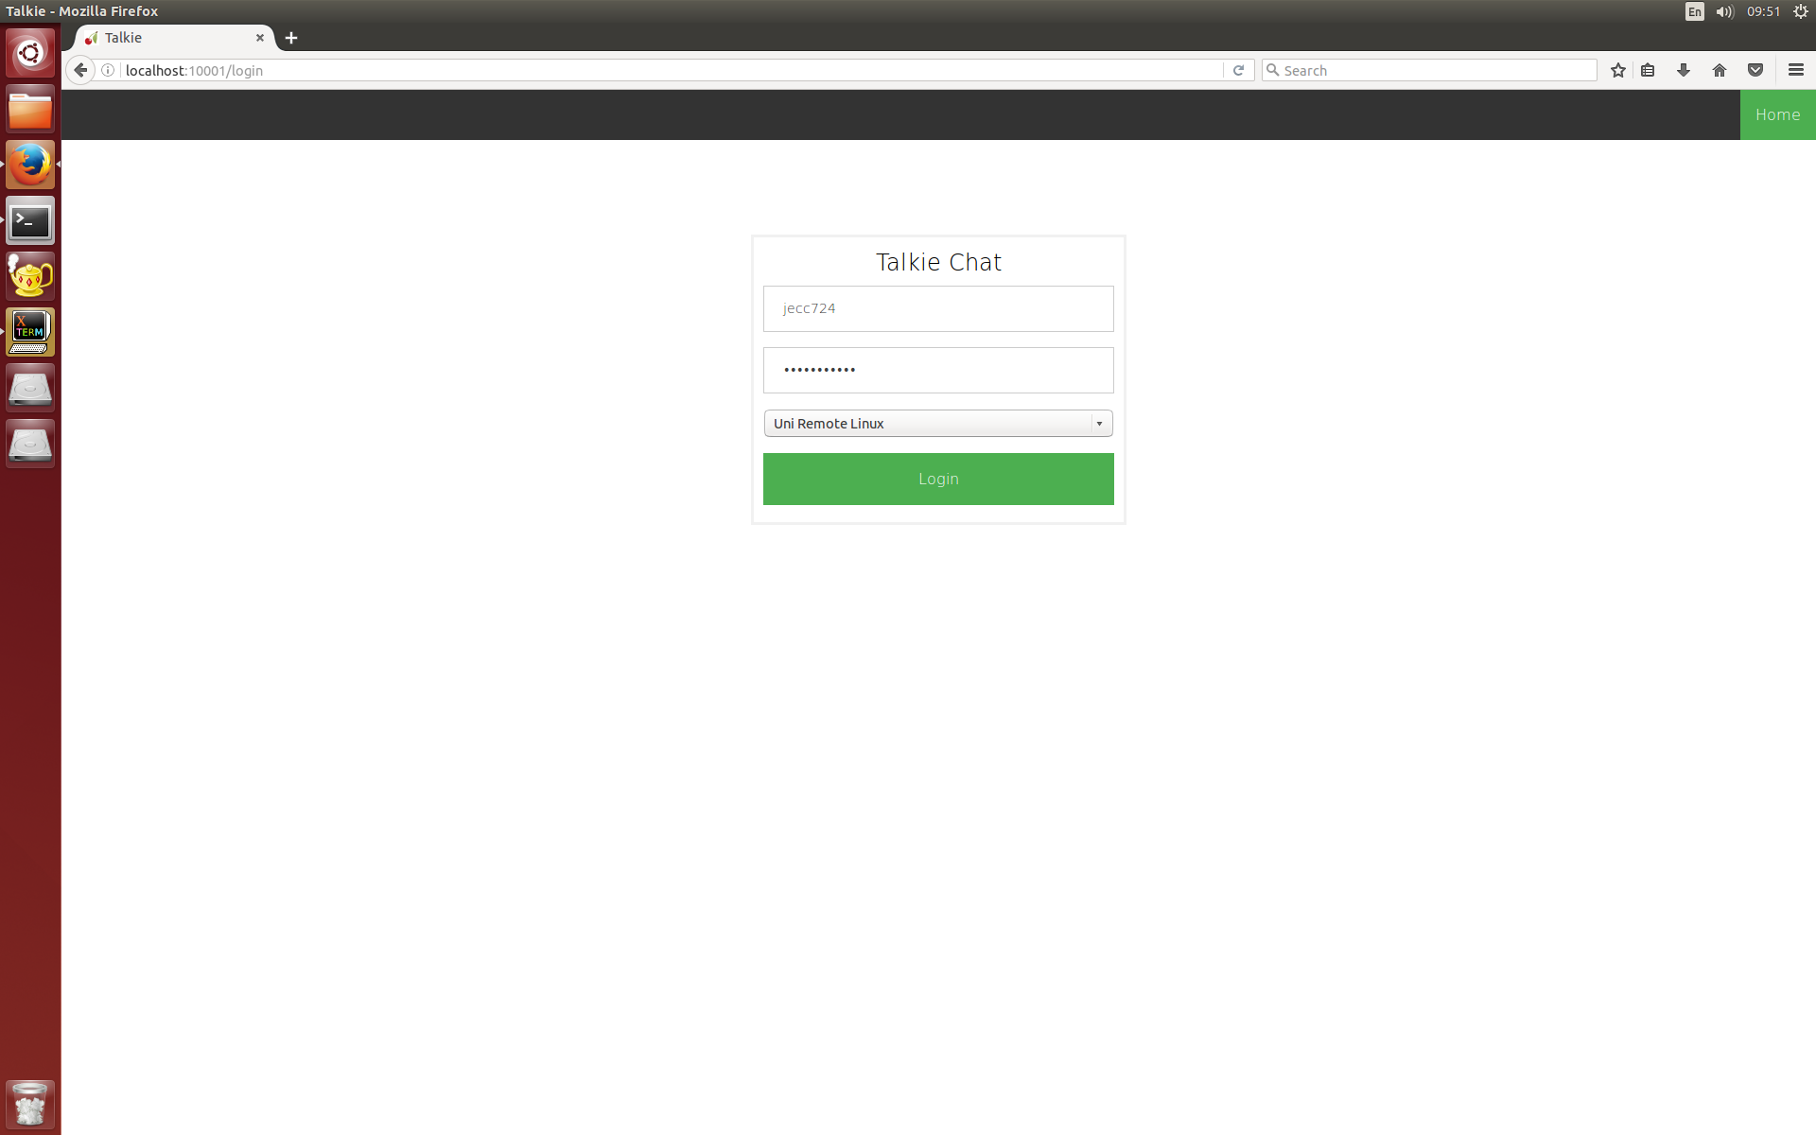
LOGIN PAGE

Slide 5
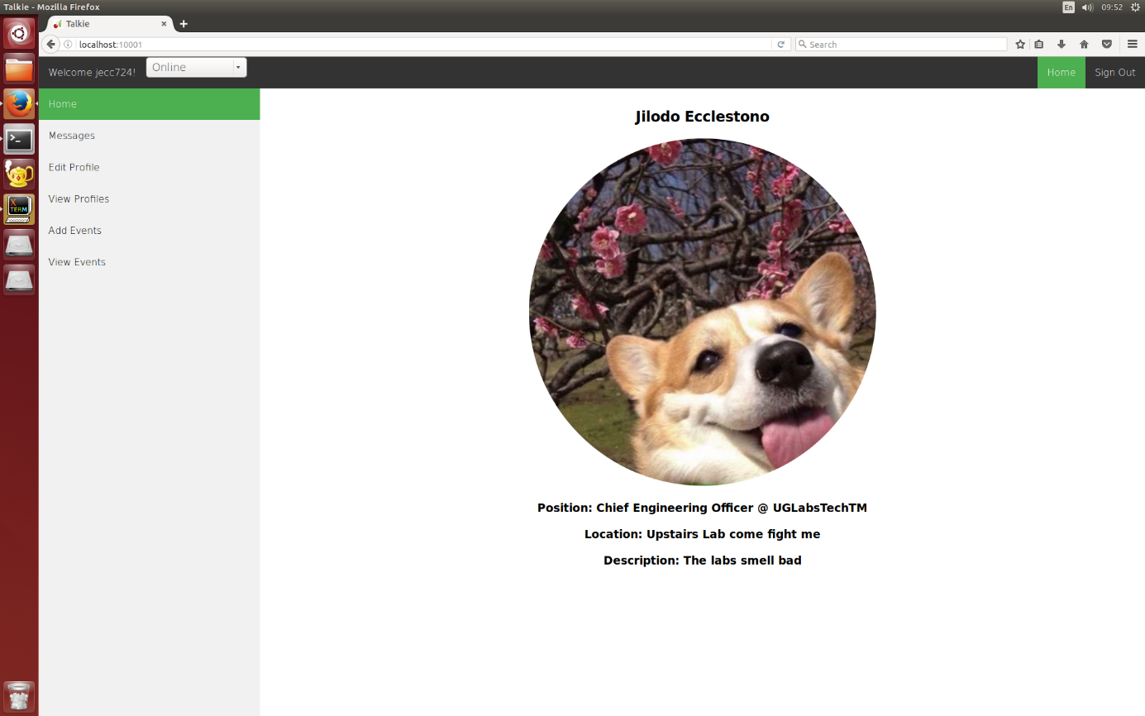
MAIN PAGE

Slide 6
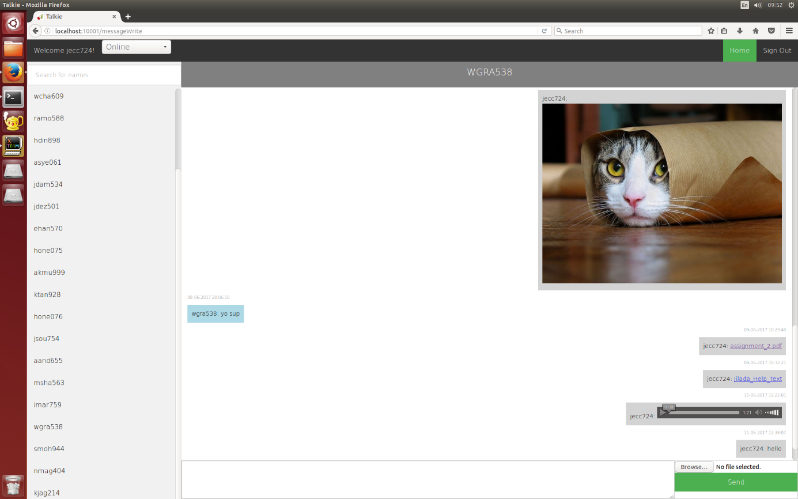
MESSAGING APPLICATION

Slide 7
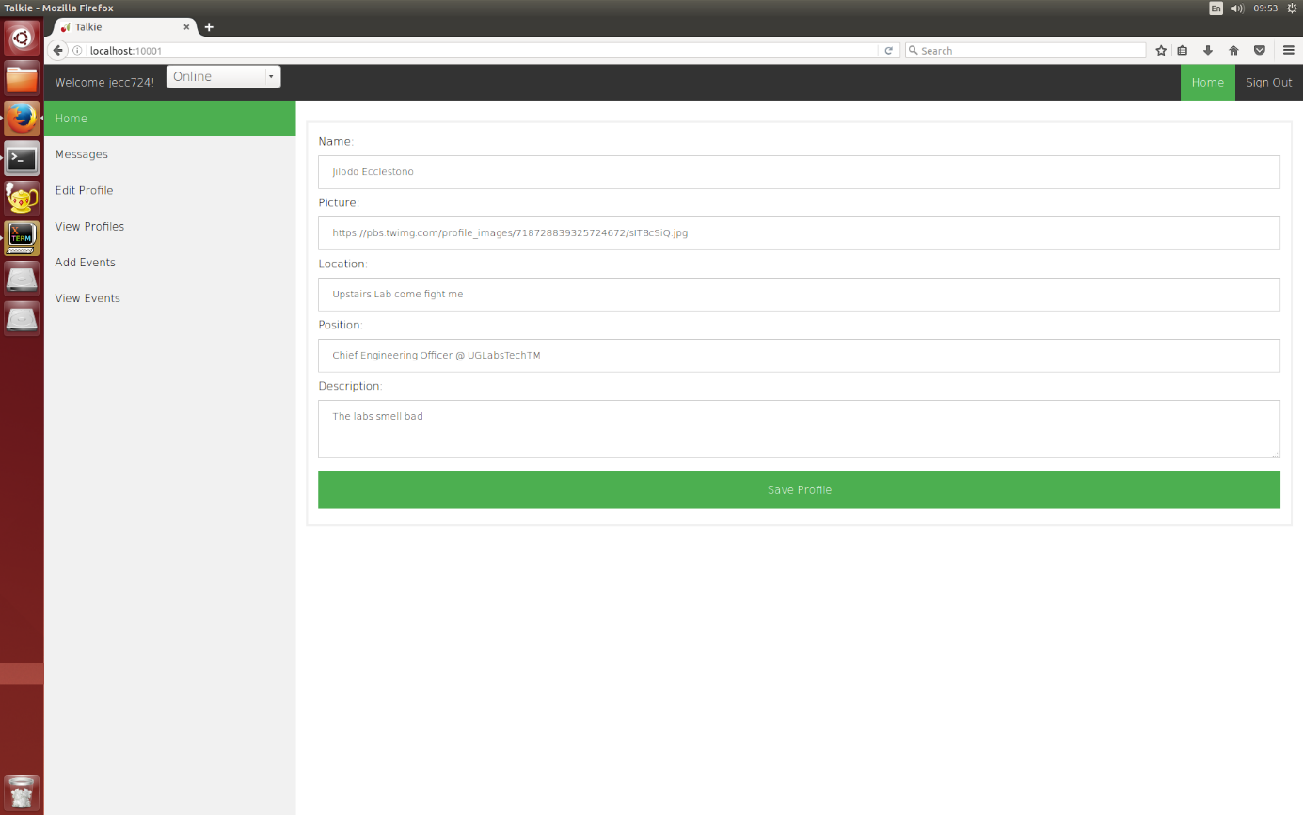
UPDATE PROFILE

Slide 8
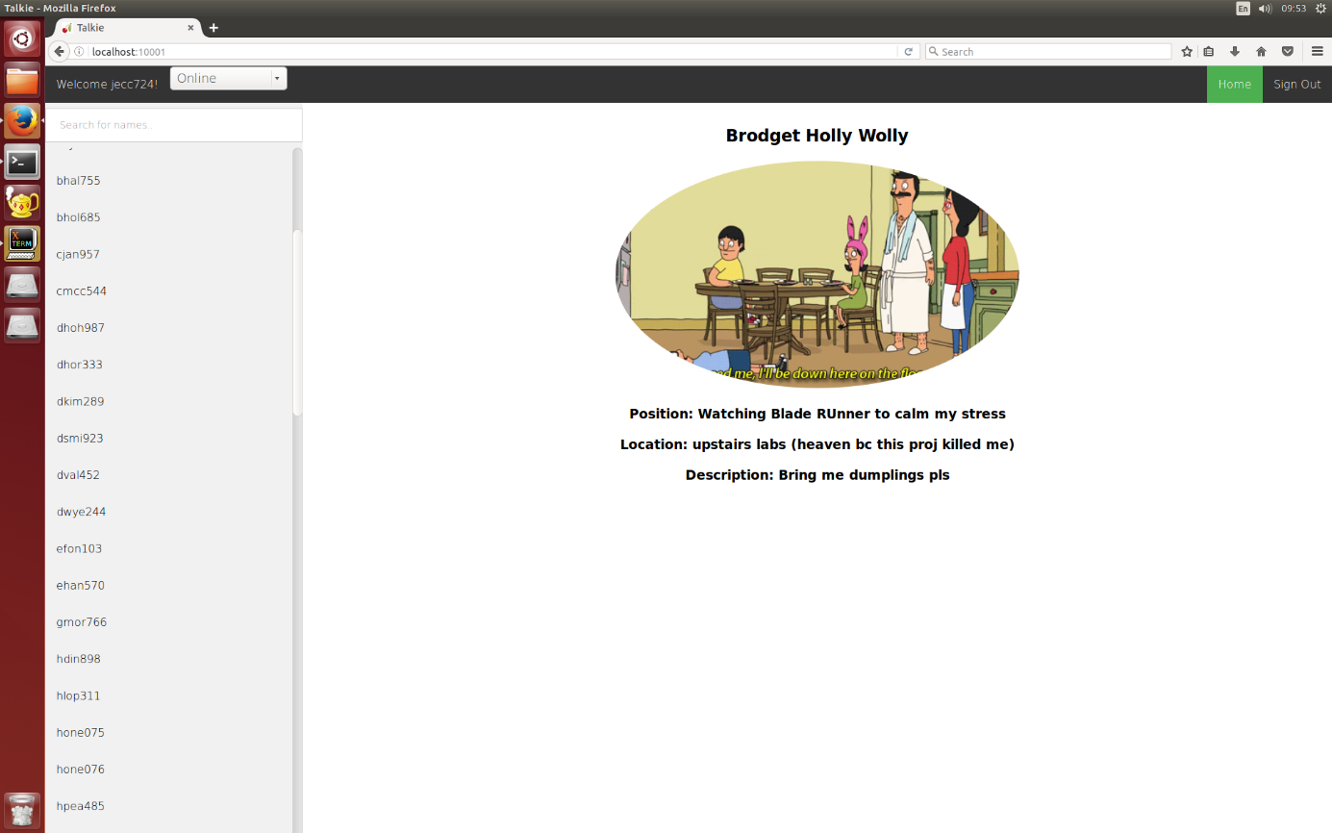
VIEW PROFILES

Slide 9
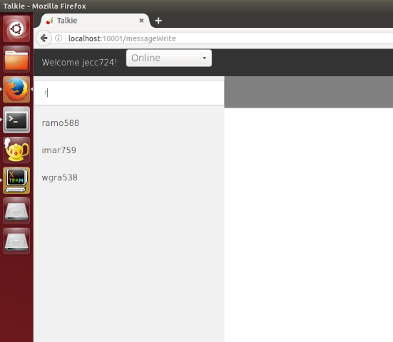

SEARCH ENGINE

Slide 10
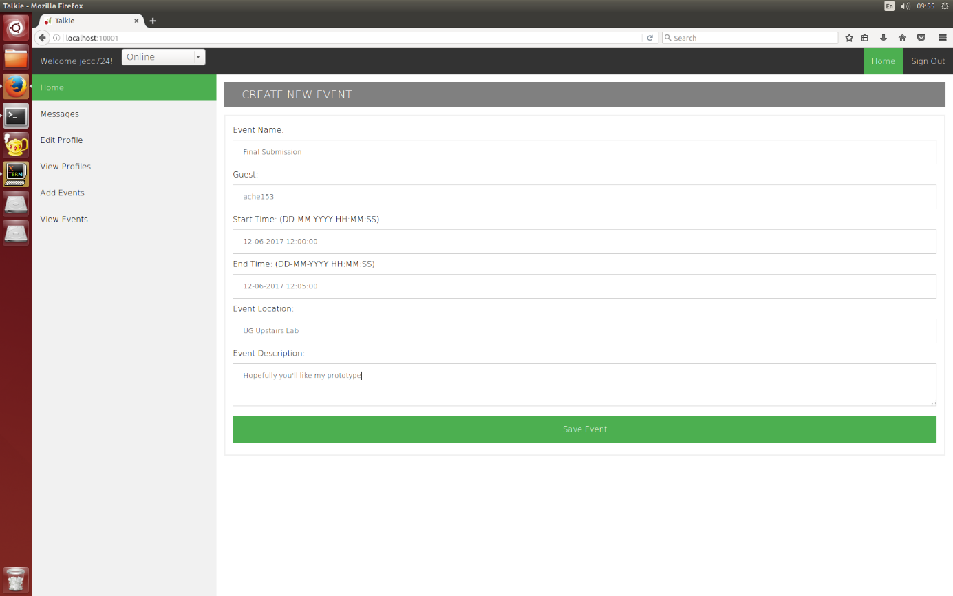
CREATE NEW EVENTS

Slide 11
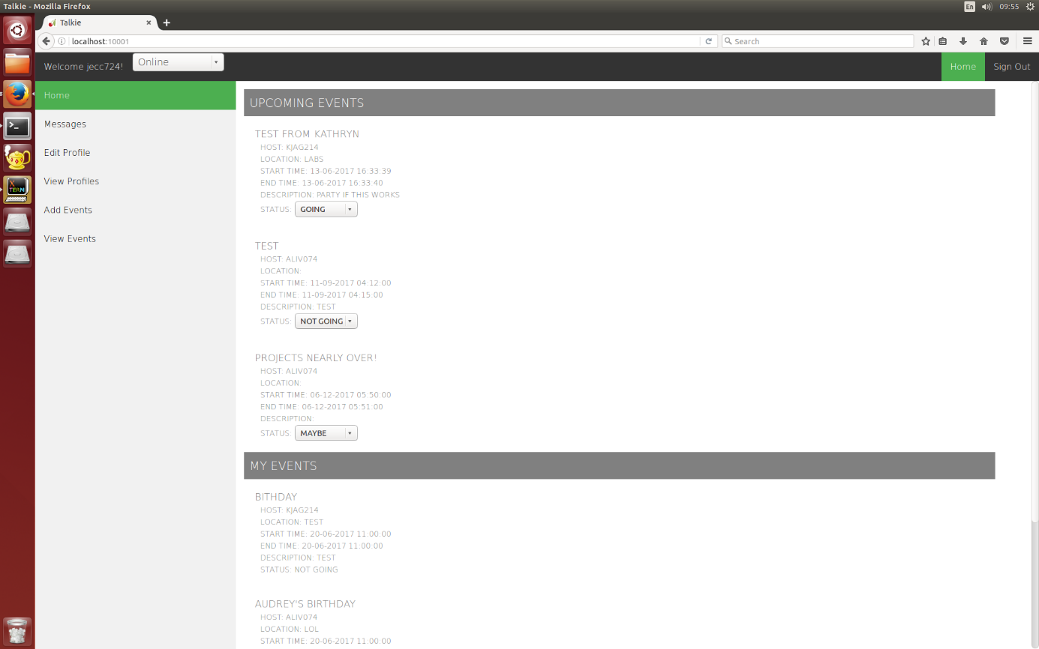
VIEW EVENTS

Slide 12
WHY TALKIE CHAT
Nice interface
Error handling stage
Potential for updates for encryption and hashing
Modularity for easy development
Good documentation and partitioning of files
Event co-ordination

